Slide 1

Title: WEATHERNOW
Student Name: k.pranay choudhary
Student ID: 2520030464
Cluster:3
Section: 11
Under the Guidance
of
Supervisor Name: Tsp.madhuri
Assistant Professor
Department of CSE

Slide 2
Abstract
The Weather Information Website is a web application that provides real-time weather data.
Users can search for any city to view its weather details.
The system fetches data from a weather API.
It displays temperature, humidity, wind speed, and weather conditions.
The project is developed using HTML, CSS, and JavaScript.

Slide 3
Existing System
Weather information usually accessed through mobile apps or TV forecasts.
Some websites are complex and difficult for beginners.
Limited customization and user interaction.
Requires installing applications.

Slide 4
Proposed System
A simple web-based weather application.
Users can search any city for weather details.
Displays real-time weather information instantly.
User-friendly interface with clear layout.
No installation required.

Slide 5
System Architecture
User enters city name in search box.
Browser sends request using JavaScript.
API fetches weather data from server.
Server sends weather information back.
Website displays data on the screen.

Slide 6
Project Modules
User Interface Module
City Search Module
Weather Data Fetching Module
Data Processing Module
Weather Display Module

Slide 7
Objectives
To design a simple weather information system.
To fetch real-time weather data using APIs.
To develop a responsive and user-friendly website .
To improve front-end development skills.

Slide 8
Co’s Attainments - FWD
CO1: Understand HTML structure.`
CO2: Design responsive layouts using CSS.
CO3: Use JavaScript for dynamic functionality .
CO4: Implement API integration.
CO5: Develop a complete front-end project.

Slide 9
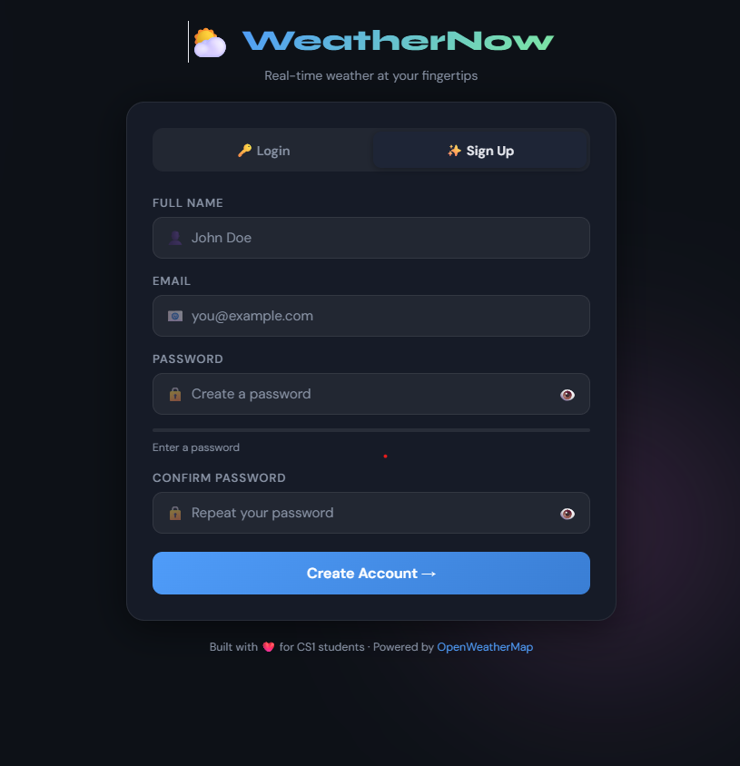
Screenshots for FWD & DSA

Slide 10
Conclusion
The Weather Information Website successfully provides real-time weather data.
The project demonstrates the use of HTML, CSS, and JavaScript.
API integration helps retrieve live data.
The system is simple, fast, and user-friendly.

Slide 11
THANK YOU

